Slide 1
Design Concepts
Software design concept will give the idea or principle behind the design.
It describes how we plan to solve the problem of designing software, and the logic, or thinking behind how we will design software.
It allows the software engineer to create the model of the system software or product that is to be developed or built.
It provides a supporting and essential structure or model for developing the right software.

Slide 2
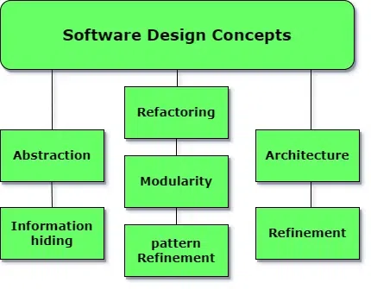
There are many concepts of software design and some of them are:

Slide 3
Abstraction (Hide Irrelevant data): To hide the details to reduce complexity and increase efficiency or quality.
Modularity (subdivide the system): Modularity means dividing the system or project into smaller parts to reduce the complexity of the system or project. In the same way, modularity in design means subdividing a system into smaller parts so that these parts can be created independently and then use these parts in different systems to perform different functions.
Architecture (design a structure of something): Architecture simply means a technique to design a structure of something. Architecture in designing software is a concept that focuses on various elements and the data of the structure.

Slide 4
Refinement (removes impurities): Refinement simply means to refine something to remove any impurities if present and increase the quality.
Pattern (a Repeated form): A pattern simply means a repeated form or design in which the same shape is repeated several times to form a pattern.
Information Hiding (Hide the Information): Information hiding simply means to hide the information so that it cannot be accessed by an unwanted party.
Refactoring (Reconstruct something): Refactoring simply means reconstructing something in such a way that it does not affect the behavior of any other features. Refactoring in software design means reconstructing the design to reduce complexity and simplify it without impacting the behavior or its functions.

Slide 5
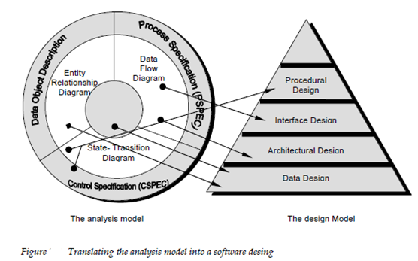
Design Model

